Slide 1
Calendar Share
Group 9

Slide 2
Team Roles
Joseph Hill – Project Manager/Backend
Robert Law – Backend/Testing
Barry Latour –
Web Frontend
Jacob Haake – Web Frontend and Security
Joel Robertson – Mobile
Miguel Cordero - Mobile

Slide 3
Application Explanation
Event driven platform designed to help users be more engaged in their community
Create or join groups to share events
Add friends and invite them to groups
Groups are collection of people and associated events

Slide 4
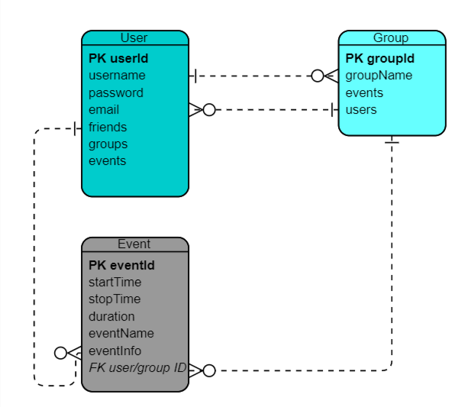
Entity Relationship Diagram

Slide 5
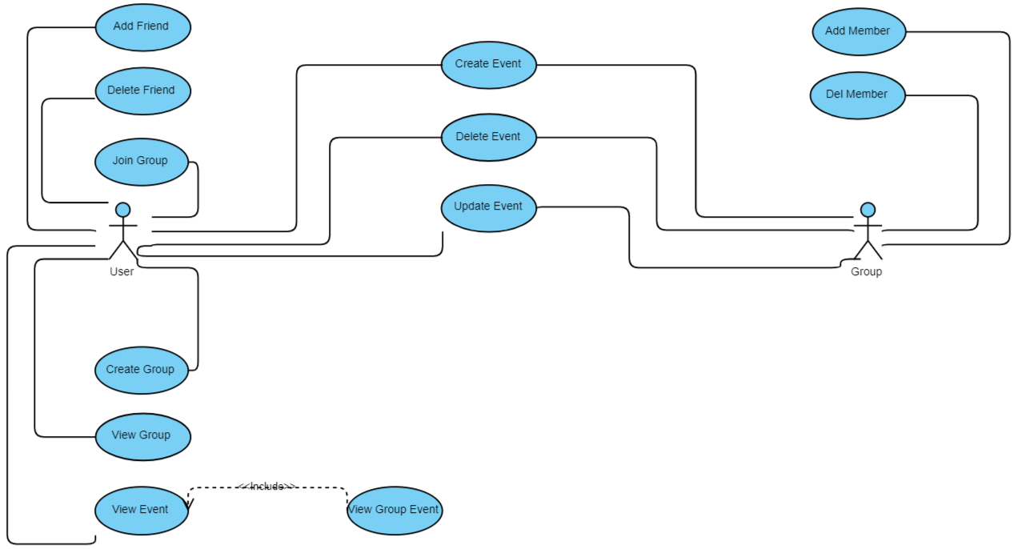
Use Case Diagram

Slide 6
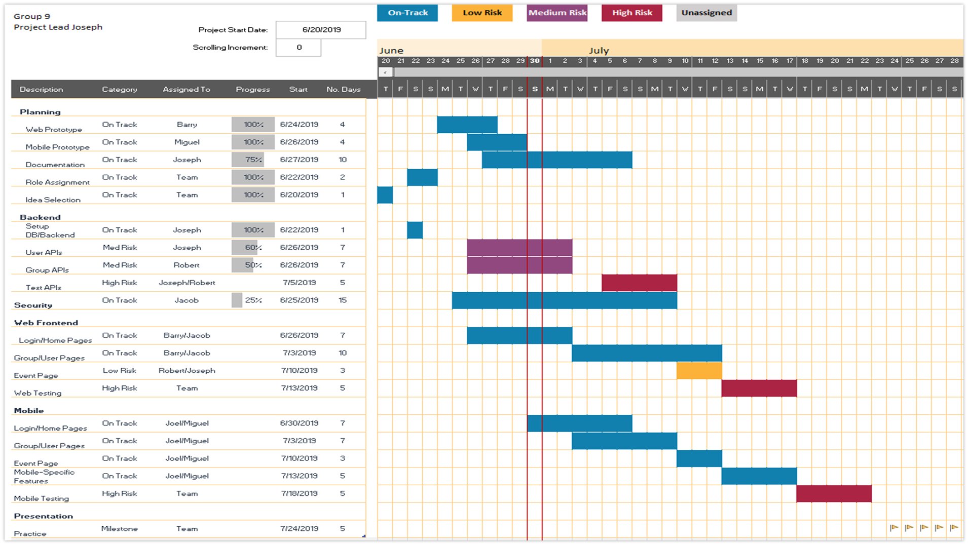

Slide 7
Backend Technology
MongoDB – NoSQL Database
Mongoose – MongoDB object modeling
Nodejs – JavaScript runtime
Express – Web framework
Heroku – cloud hosting platform
Postman – API testing

Slide 8
Web Technology
React – front end framework
mdbootstrap – bootstrap components for React
Js-sha256 – hash and salt passwords
Axios – Promised based https clients

Slide 9


Mobile Technology
Flutter – mobile application framework
Dart – programming language for Flutter
Target Mobile OS – Android
Dart crypto – Use to hash/salt passwords

Slide 10

Web Demo

Slide 11
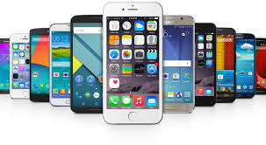
Mobile Demo

Slide 12
Roadblocks
Start mobile from scratch
Learning mobile application development
Short timeline
Can’t meet often
Not enough communication
Life events

Slide 13
Lessons Learned
Plan architecture ahead
Plan UI ahead of time
Plan before coding
Understand frameworks before trying to code
Make sure everyone understands requirements
Don’t procrastinate

Slide 14


Questions?

